Slide 1
Military Lotteries Vietnam-Era National Service in Australia (1965-1972)
Peter Siminski
University of Technology Sydney
Canberra, 12th of May 2025
Graphics created by Ullupta conecum re volupta evelignis pe et doluptuam.

Slide 2
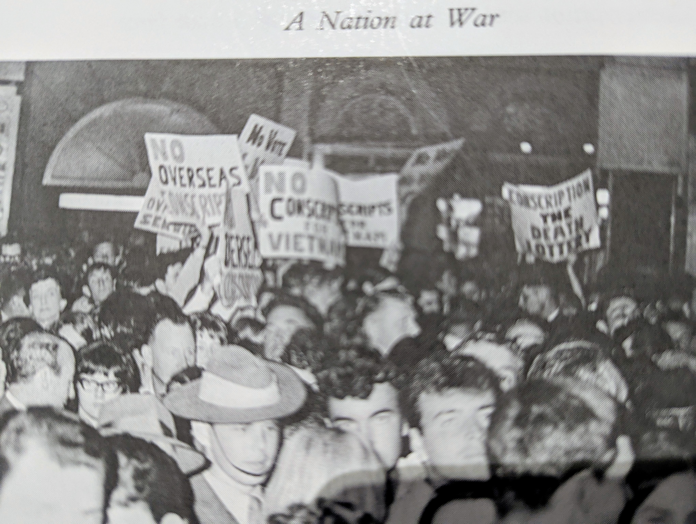
Intro
Most significant policy-by-lottery in Australia’s history
Was it a good idea?
Overview
Rationale and Objections
Reflections

Slide 3
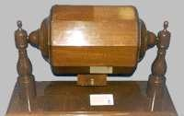
Overview
Two lotteries / year = 16 lotteries
20 yo men required to register for lottery
By date of birth
National Service = Army for two years, then reserves for three years
804,286 registered, 237,048 balloted-in, 63,375 enlisted, 18,654 served in Vietnam

Slide 4
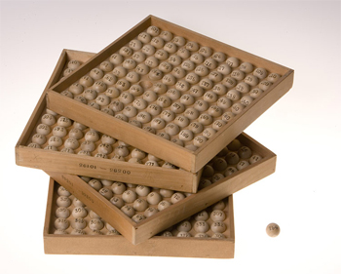
Example: Balloted-in DOBs in the 1965 lotteries
January 1, 3, 4, 5, 6, 7, 8, 9, 10, 12, 13, 14, 21, 23, 27, 28
February 1, 2, 4, 5, 6, 9,12, 14, 16, 17, 19, 20, 21, 23, 24, 25, 26
March 2, 3, 5, 8, 9, 10, 11, 12, 13, 15, 17, 18, 20, 24, 26, 27, 28, 29,30
April 1, 3, 4, 6, 7, 8, 11, 13, 14, 19, 20, 21, 22, 23, 26, 29
May 1, 2, 4, 5, 8, 9, 12, 14, 19, 22, 23, 26, 30
June 2, 6, 7, 8, 9, 10, 12, 14, 15, 17, 20, 21, 25, 26, 29
July 3, 6, 7, 8, 16, 22, 25, 26, 31
August 3, 6, 9, 11, 12, 13, 14, 15, 16, 20, 21, 22, 23, 25, 26
September 2, 4, 5, 6, 14, 17, 21, 25, 26
October 2, 4, 5, 6, 10, 11, 13, 16, 17, 23, 25, 29
November 3, 4, 12, 14, 15, 16, 22, 24, 27
December 6, 10, 12, 14, 17, 18, 19, 21, 24, 25, 26, 28, 31

Slide 5
Rationale for, & Objections to the Lottery
Much objection! But let’s distinguish between:
Decision to participate in the war
Conscription (and deployment to Vietnam)
The lottery mechanism
Rationale for the mechanism
Manpower needs too large for all-volunteer force, too small for universal conscription
Perceived fairness
Flexibility to vary intake over time
Objections to the mechanism
‘gambling’ with peoples’ lives – “lotteries of death”
Many arbitrary, non-random factors also determined selection
Limited transparency – rumours of manipulation

Slide 6
Non-random factors in selection
Differences between birth-cohorts in:
P(balloted-in) → varied from 53% to 16%
P(enlist | balloted-in) → reduced steadily from 36%
P(deployment | enlist) 39% → 53% → 0%
1st cohort suffered over ¼ of all Nasho deaths!
Exemptions and Deferments
Medical assessment; Students; Married before call-up; some migrants, etc.

Slide 7
Reflections
The most significant policy-by-lottery event in Australia’s history
Extremely controversial context
Used for an Under-subscribed ‘program’ with forced participation
Objections to the mechanism
It wasn’t random enough!
It was too random?
Not as significant as objections to the war and to conscription per se
Overall the lottery mechanism was probably a good idea

Slide 8
Lotteries for ARC Grant Allocation?
Peter Siminski
University of Technology Sydney
Canberra, 12th of May 2025
Graphics created by Ullupta conecum re volupta evelignis pe et doluptuam.

Slide 9
Background
ARC Discussion Paper Feb 2025
Policy Review of the National Competitive Grants Program
“Streamlining processes and improving administration”
“Where practicable, schemes will use a two-stage ‘idea first’ double blind assessment, focusing initial peer review on the quality of the research idea. The ARC will incorporate learnings from its existing two-stage model to improve administrative efficiencies
Existing two-stage model
Used for DP25 (and DP26, DP27)
1st stage: 2-page project description, 27.5% shortlisted
2nd stage: full application, 47.3% successful (13.0% overall)

Slide 10
Proposal for Analysis of DP25 data
Overarching themes
Estimating benefits and costs of each review stage
Consider alternate mechanisms
Explore correlations in rankings
Multiple reviewers on each application in each round
True quality is unobserved
Rankings have ‘signal’ and ‘noise’
How correlated are rankings within applications
In 1st stage
In 2nd stage (are 2nd stage reviews less ‘noisy’ than 1st stage?)
between stages (does 2nd stage reveal important new information, or more of the same?)

Slide 11
Hypotheticals (1)
1st stage rankings correlate exactly with 2nd stage rankings
→ Second stage unnecessary

Slide 12
Hypotheticals (2)
1st & 2nd stage rankings unrelated
One or both stages are uninformative OR 2 stages elicit different information
Examine correlations within and between stages

Slide 13
Hypotheticals (3)
1st & 2nd stage rankings correlated
→ Does 2nd stage provide a stronger signal, a different signal, or just more info at a higher cost?
Examine correlations within and between stages

Slide 14
Hypotheticals (4)

Slide 15
Alternative mechanisms include:
Use stage 1 ranking only
Randomly allocate after stage 1 (amongst short-listed applications)
Exempt highest ranking applicants from stage 2. For others:
Use “stage 2”
Randomly allocate
Change proportion shortlisted
A case for (propensity score) weighted randomisation?
Estimate costs and benefits of each option
Costs to applicants, assessors, administrators, including delays
Cost of grant allocation ‘errors’
Ideally – specify an ‘objective function’ for the grant allocation problem, and optimise design features accordingly

